Slide 1



POTHOLE DETECTOR
Using Python

Slide 2
GROUP MEMBERS
Hafsa ali CR-22006
Daniya Fazal CR-22007

Slide 3
OBJECTIVE
To develop a deep learning-based system that can detect potholes in road images and videos using a Convolutional Neural Network (CNN).

Slide 4
How It Works?
01
Input: Road image/video/webcam stream
Preprocessing: Grayscale conversion, resizing to 100x100
Model Inference: CNN predicts pothole presence
Output: Displays bounding box and label if pothole is detected
02
03
04

Slide 5
Libraries
os
For file path management and directory traversal
cv2 (OpenCV)
Image/video reading, processing, and display
numpy
Numerical operations and array handling
tensorflow / keras
Model building, training, and prediction
sklearn
train_test_split for dataset splitting

Slide 6
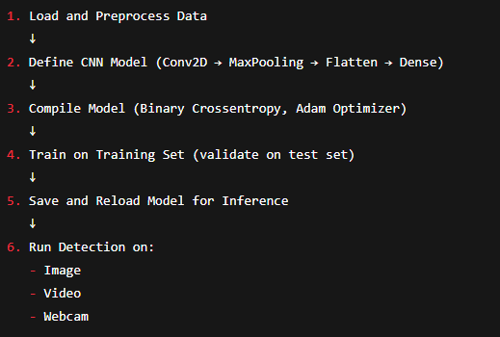
Flow Of Code Execution

Slide 7
Advantages
🚗 Real-time detection possible on webcam and video
🔍 High accuracy using deep learning (CNNs)
🔧 Low-cost solution using standard cameras
♻️ Reusable architecture for other object detection tasks

Slide 8
Disadvantages
⚠️ False positives/negatives due to lighting or shadows
🧠 Model requires large, diverse dataset for generalization
📦 Cannot localize exact pothole boundaries (image-level only)
⏱️ Slower inference on non-GPU systems

Slide 9
Future Work
✅ Integrate object detection models like YOLOv8 for bounding boxes
🗺️ Generate heatmaps of road damage over time
⌛ Add timestamped logs for pothole occurrences
📡 Connect with IoT sensors for real-world deployment

Slide 10
Industrial Aspect
🏙️ Smart Cities: Automated road monitoring & maintenance planning
🚧 Municipal Corporations: Efficient identification and prioritization of repairs
📊 Data Analytics: Insight into traffic conditions and wear patterns
🤖 Autonomous Vehicles: Pothole avoidance system integration

Slide 11

THANK YOU

